Slide 1
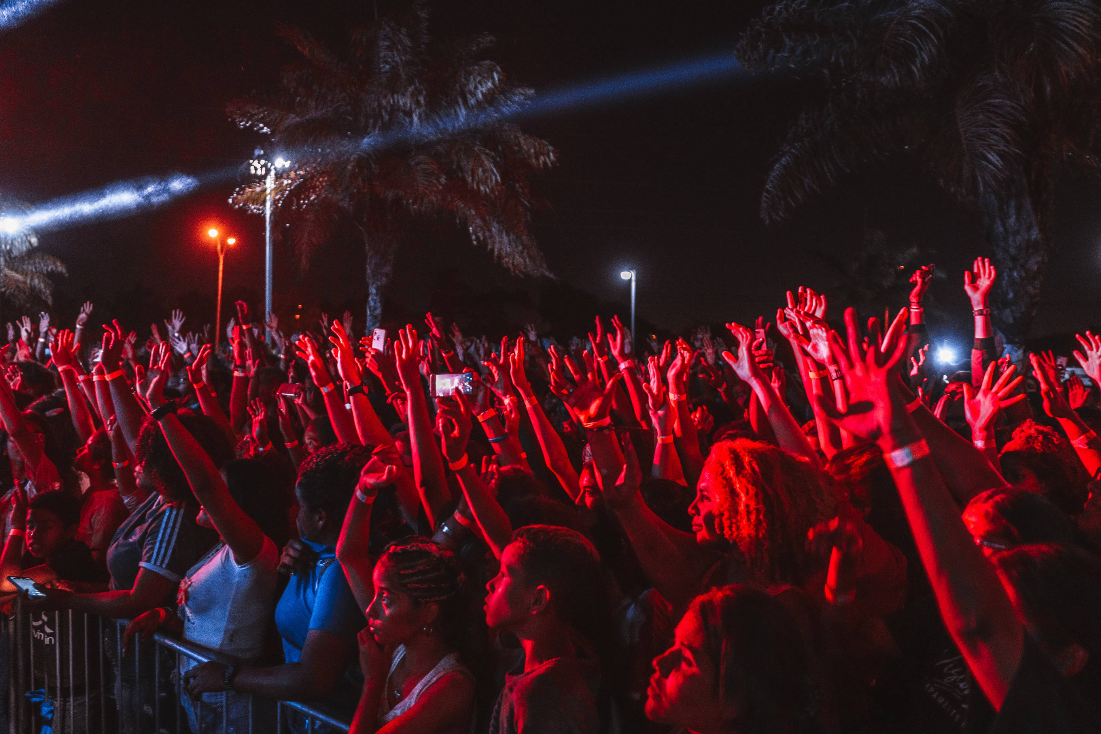





VIGNANA JYOTHI INSTITUTE OF MANAGAMENT
MILAN 8.0
CHRYSALIS
2026
Head Co-Ordinators:
Sara Praneeth : 79939 31713
Kotte Harshitha : 87121 43102
Mallai Charan : 99491 62851
Annika Rao : 96186 82968
Chrysalis – Knowledge, Creativity & A Night Full of Beats

Slide 2

Singing Competition
“Don’t hide your voice—let it rise and shine”
Rules And Regulations:
The competition will be held in 3 rounds.
The participants should send their raw audio clips for round 1 ( preferably 1 min audio clip)
There will be a live audition for 2nd round with a time limit of 4 min.
The third and exciting round consists of a mashup session where the selected participants would sing a mashup (a mix of 2 or more songs) with a time limit of 5 minutes maximum
Team Size : Solo (or) Duo (or) 4 members
Entry fee for singing per head Rs.200
For Queries Contact
Chatla Shivani: 9701050561
D.Yuktha Sai Harshitha: 8074412297

Slide 3

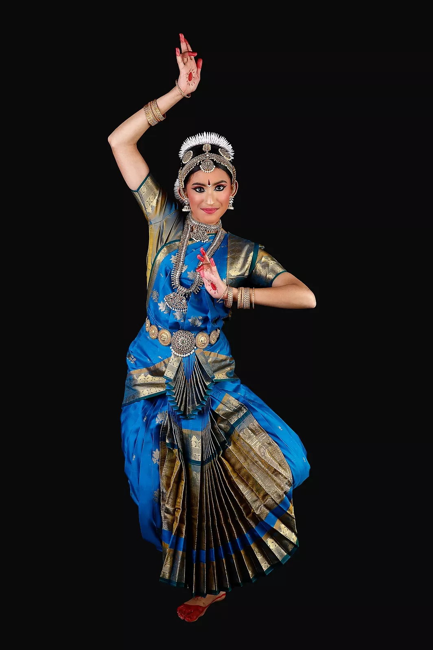
Dancing Competition
“This is your moment - dance like the spotlight is yours!”
Event Guidelines
Mandatory registration before the event date
Competition will be conducted in two rounds
All dance styles are accepted
Solo & Group performances allowed
Group size: Min. 3 Members & Max. 6-8 members
Time limit for round 1: Solo- 2 mins & Group 3 mins
The Time Limit for Round 2 depends on the
Participants selected for round 2

Slide 4
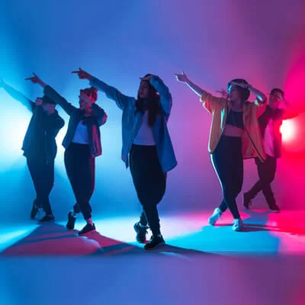
Dancing Competition
“This is your moment - dance like the spotlight is yours!”
Teams must provide accurate participant details
Performance music to be submitted in MP3 format
Props are allowed (should be safe)
Exciting prizes for top performers
Special recognition for Creativity, Costumes & Presentation
Entry fee:
Rs. 200/- for Solo performances
Rs. 500/- for Group performances
Performance & Rewards
For Queries Contact:
B.Srichand: 91003 26064
Kunaparaju Lahari: 79810 98421

Slide 5
Rampwalk Competition
“Walk the ramp like it’s your runway - confidence is your best outfit”
Event Overview & Rounds:
Theme: Netflix & Fashion (Inspired by famous series/movies – subtle & stylish presentation)
Time Limit: 45 seconds per participant
Competition Rounds:
Round 1: Solo Ramp Walk
Round 2: Paired Walk (Pairs will be selected by judges)
Round 3 (Final): Solo Walk (Participants selected from Round 2)
Final Round Interaction:
Judges will ask basic questions about your outfit or character inspiration

Slide 6

Rampwalk Competition
“Walk the ramp like it’s your runway—confidence is your best outfit”
Rules And Regulations:
Vulgarity or obscenity is strictly prohibited
Use of cigarettes, alcohol, or unfair means is not allowed
Violation of rules will lead to immediate disqualification
Costume & Styling
Theme Interpretation
Walking Stance & Confidence
Order of ramp walk may be random
Entry Fees: Rs.100 Per Head
For Queries Contact
Meghana: 90590 54180
P. Akshaya Reddy: 98582 88898

Slide 7
Painting Competition
“Turn your thoughts into colors and dreams into art.”
Event Guidelines
Game Type: Individual | Theme-Based | Fun & Creative
Theme : What if time can be painted ?
It is an on-the-spot painting competition where participants visually express time as an emotion, journey, or force. At the beginning of the event, one participant will be invited to pick a chit randomly, and the concept written on that chit will be announced as the common topic for the day, which all participants must paint. The topics explore different dimensions of time such as Past–Present–Future in one canvas, Aging, Frozen Moments, Fast vs Slow Time, Time as a Healer or Destroyer, and symbolic clocks. Participants must creatively translate the announced concept into a single canvas within the given time limit
OBJECTIVES :
• Encourage creativity and artistic expression
• Provide a platform to showcase painting skills
• Promote innovation, originality, and conceptual thinking

Slide 8

Painting Competition
“Turn your thoughts into colors and dreams into art.”
RULES & REGULATIONS
• College ID is mandatory. Only one artwork per participant.
• Time limit must be strictly followed; late submissions not accepted.
• Only manual painting/drawing allowed; no digital art or references.
• Cell phones, books, and external help are prohibited.
• Plagiarism or pre-made work leads to disqualification.
• Co-operate with the Judges Decision, Judge’s decision is final.
Materials Allowed: Watercolors, Acrylics, Poster Colors, Oil Pastels, Color Pencils, Brushes, Palette, Water Container.
Participants should bring their own materials.
Organizers will provide chart paper, pencils, erasers, and sharpeners.
NOTE: Judging is based on creativity, idea, and execution irrespective of material cost. All painting materials are allowed.
Entry Fees: Per person Rs.200/-
For Queries Contact
L. Nanditha: 90326 05728
Hema Priya: 73307 63229

Slide 9
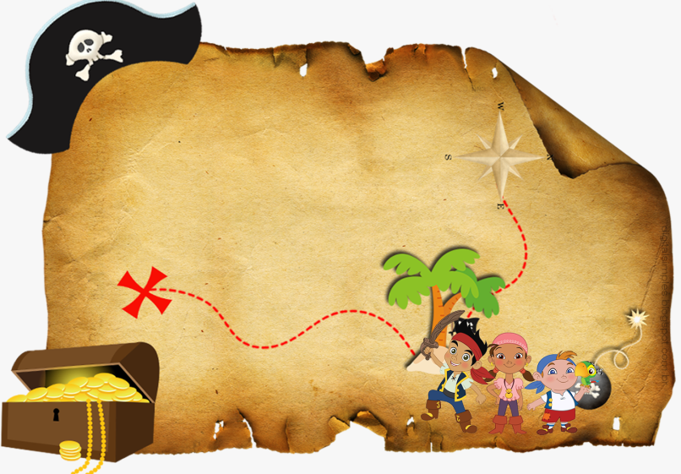
Treasurehunt Competition
“Every clue is a step closer to victory—keep exploring, keep believing!”
Event Guidelines
Participating teams must have a minimum of 3 and a maximum of 5 members.
On finding the clue, the team must post a picture taken by the team members along with The clue on the WhatsApp group created by the event coordinator.
The clues will be the same for all the groups.
The decision of the organizing committee is final.
Entry fee:
Treasure hunt 3 to 5 members Rs.300 & Individual Rs.100

Slide 10

Photography Competition
“Where passion meets precision”
Event Guidelines
Round-1 Each individual must take a candid picture.
Round-2 Each qualified individual must take a portrait picture.
Round-3 Each qualified individual must take a picture with a message-oriented theme which they need to explain.
3 rounds will be conducted
Registration Fee- Rs.200/-

Slide 11
Academic Competitions CONTENT
01. MARKETING (MAD) 02. OPERATIONS (OPTIMOPS) 03. HR (HUMANEERS) 04. FINANCE (FINFUNDA)

Slide 12
Marketing Event (MAD)
Round 1: Audio Brand Identification (Screening Round)
Objective: To test participants brand recall and advertising awareness.
Rules:
Team Size : 2- 3 Members
Participants will be played a series of audio clips (advertisement jingles or background music)
Each audio clip will correspond to a product or service brand.
Participants must correctly identify the product or service and give the answer within the allotted response time. Evaluation will be based on the number of correct identifications.
Based on performance, a predefined number of participants will be shortlisted for Round 2.
The decision of the judges and event coordinators will be final and binding.

Slide 13
Marketing Event (MAD)
Round 2: Mystery Box Investor – Product Reinvention
Objective: To evaluate participants’ ability to redesign and reposition a given product into a market-ready business concept using innovation and strategic marketing thinking.
Rules:
Each team will receive one product along with a market constraint.
Teams must reimagine and upgrade the given product into a new or improved offering. Selling the product in its original form is not permitted.
Teams will be given 5 minutes for preparation.
Each team will get 3 minutes to present, followed by 2 minutes of judge interaction.
Use of mobile phones or external materials is strictly prohibited.
The decision of the judges will be final and binding.
Evaluation Criteria:
Innovation and creativity
Market relevance and feasibility
Branding and positioning clarity
Confidence and response to judges
Qualification:
Top-performing participants will qualify for Round 3

Slide 14
Marketing Event (MAD)
Round 3: Marketing Rapid Fire – Final Round
Objectives: To test quick decision-making under high-pressure situations.
To evaluate practical marketing thinking and business instincts.
To assess confidence, clarity, and real-world problem-solving ability.
To identify participants who think and respond like managers in crises.
Rules:
Top-qualified finalists will participate and stand in a single line.
Each participant will be given 15 seconds to answer each question.
No preparation time or discussion is allowed at any stage.
Delayed responses, repeated answers, or vague replies will lead to elimination.
Questions will focus on crisis management, pricing decisions, consumer behaviour, promotions, and marketing strategy.
Participants must maintain professionalism and respectful conduct throughout the round.
Any form of misconduct will result in immediate disqualification.
The last remaining participant will be declared the winner.
For Queries Contact
SVS Rishitha: 63056 14798
Muskan Singh: 70131 24225
Registration fees per head- Rs.200/-

Slide 15
Operations(OPTIMOPS)
The Ops-Matrix: Optimize to Win Where theory meets the factory floor. Prove your analytical grit in this two-part operations challenge.
Team Size: 2–3 Member
Round 1: The Opera Quiz
Format: 20-question (15mins)
Focus: Core concepts of Operations and Supply Chain Management.
Top 6 teams are qualified to next round
Round 2: The Simulation
Format: Data-driven case study.
Task: Arrive at the Lowest Cumulative Cost (MRP)
Goal: Calculate and achieve the lowest cumulative cost through optimized flow.
Requirement: Teams must use the provided caselet data to justify their answer
The Tie-Breaker Rule: If two or more teams arrive at the exact same lowest cost in Round 2, their Round 1 Quiz scores will be used as the decider to crown the champion.
Registration fees per head- Rs.200/-
For Queries Contact
C. Saakshi: 79891 94934
Sahithi: 86883 51758

Slide 16
HR (Humaneer)
ROUND 1: TASK & TARGET CHALLENGE (“Plan Smart. Act Fast. Achieve Targets”)
Task 1 : Goal Achievement
Teams must solve an HR – related riddle and give a clear answer
Each team will be provided with two HR- related riddles and must answer both within a time limit of one minute .
Time limit: 8 – 10 minutes
Task 2 : Target Execution
Teams must complete a physical coordination challenge requiring teamwork and collective efforts .
Time Limit : 5 minutes
Team Size : 2- 3 members

Slide 17
HR (Humaneer)
ROUND 2: Mind the Order
In this activity, 20 blocks numbered from 1 to 20 are placed randomly on the ground.
Team members must cross the blocks in numerical order, stepping on one block at a time, one member after another, while coordinating as a team.
The challenge tests focus, memory, teamwork, and pressure handling.
A single mistake sends the entire team back to the starting
Rules and Regulations:
Block Sequence Rule: Blocks are placed randomly, and teams must step strictly in order from 1 to 20. Any wrong step or skipped number means restarting.
Movement Rule: Only one team member moves at a time, and members must cross one by one, not together.
Ground Rule: If any member touches the ground outside the blocks, the team must restart from the beginning.
Time & Winning Rule: The game is played within a fixed time limit (e.g., 2 minutes). The team that completes the sequence correctly in the shortest time wins.
Registration fees per head- Rs.200/-
For Queries Contact
Prachi Kushwaha: 80045 96042
YDSN Sathwika: 63021 36641

Slide 18
Finance (FINFUNDA)
EVENT: BASIC FINANCE QUIZ (3 ROUNDS) Team size 3-5 members
This event is designed to test participants’ basic finance and accounting knowledge in a short, simple, and engaging format.
ROUND 1: FINANCE BASICS BLITZ
Format: Multiple Choice / Direct Questions
Topics: Assets, Liabilities, Accounting Equation, Profit & Loss Scoring: +10 for correct answer, 0 for wrong answer
Time Limit: 8–10 minutes
ROUND 2: FINANCE SITUATION ROUND
Short real-life finance situations will be given
Teams get 30 seconds to discuss
Focus on application of basic concepts
Scoring: +20 for correct, +10 for partial answer
Time Limit: 8–10 minutes

Slide 19
Finance (FINFUNDA)
ROUND 3: RAPID FIRE – TRUE OR FALSE
5 rapid questions per team
Answer within 3 seconds
Scoring: +5 for correct, –5 for wrong (optional)
Time Limit: 5 –7 minutes
WINNER SELECTION:
The team with the highest total score across all three rounds will be declared the winner. In case of a tie, a sudden-death finance question will be asked.
Registration fees per head- Rs.200/-
For Queries Contact
PV Karthikeya : 76010 33418
Vaishnavi : 79073 43214

Slide 20

THANK YOU

